Slide 1
Unit 8:
RMI and CORBA

Slide 2
Introduction of RMI
The RMI (Remote Method Invocation) is an API that provides a mechanism to create distributed application in java.
A distributed system, also known as distributed computing, is a system with multiple components located on different machines that communicate and coordinate actions in order to appear as a single coherent system to the end-user.
The RMI allows an object to invoke methods on an object running in another JVM.
The RMI provides remote communication between the applications using two objects stub and skeleton.

Slide 3
Goals of RMI
To minimize the complexity of the application.
To preserve type safety.
Distributed garbage collection.
Minimize the difference between working with local and remote objects.

Slide 4
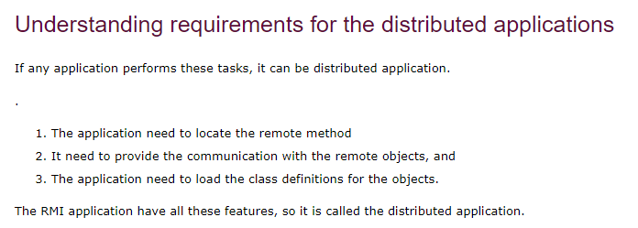

Slide 5
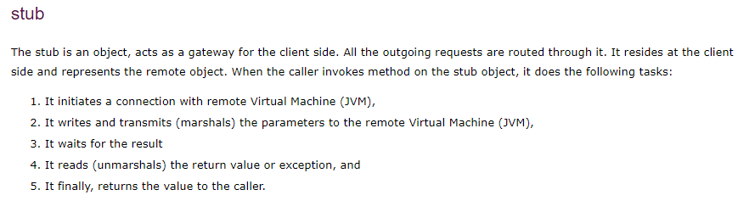
Understanding stub and skeleton RMI uses stub and skeleton object for communication with the remote object. A remote object is an object whose method can be invoked from another JVM.

Slide 6
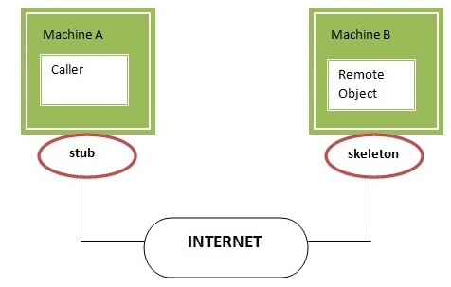
Skeleton
The skeleton is an object, acts as a gateway for the server side object. All the incoming requests are routed through it. When the skeleton receives the incoming request, it does the following tasks:
It reads the parameter for the remote method
It invokes the method on the actual remote object, and
It writes and transmits (marshals) the result to the caller.
In the Java 2 SDK, an stub protocol was introduced that eliminates the need for skeletons.

Slide 7
Architecture of an RMI Application
In an RMI application, we write two programs, a server program (resides on the server) and a client program (resides on the client).
Inside the server program, a remote object is created and reference of that object is made available for the client (using the registry).
The client program requests the remote objects on the server and tries to invoke its methods.

Slide 8
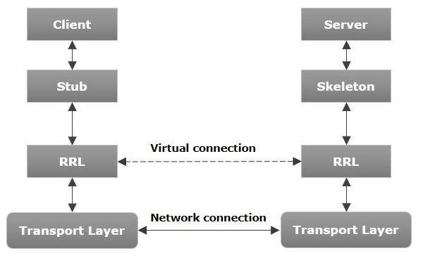
RRL(Remote Reference Layer) − It is the layer which manages the references made by the client to the remote object.
Transport Layer − This layer connects the client and the server. It manages the existing connection and also sets up new connections.

Slide 9
Working of an RMI Application
When the client makes a call to the remote object, it is received by the stub which eventually passes this request to the RRL.
When the client-side RRL receives the request, it invokes a method called invoke() of the object remoteRef. It passes the request to the RRL on the server side.
The RRL on the server side passes the request to the Skeleton (proxy on the server) which finally invokes the required object on the server.
The result is passed all the way back to the client.

Slide 10
RMI Registry
RMI registry is a namespace on which all server objects are placed.
Each time the server creates an object, it registers this object with the RMIregistry (using bind() or reBind() methods). These are registered using a unique name known as bind name.
To invoke a remote object, the client needs a reference of that object. At that time, the client fetches the object from the registry using its bind name (using lookup() method).

Slide 11
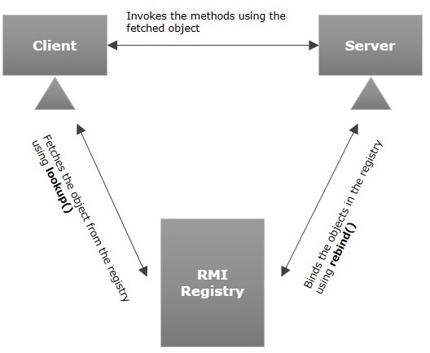

Slide 12
Java RMI Example
The is given the 6 steps to write the RMI program.
Create the remote interface
Provide the implementation of the remote interface
Compile the implementation class and create the stub and skeleton objects using the rmic tool
Start the registry service by rmiregistry tool
Create and start the remote application
Create and start the client application

Slide 13
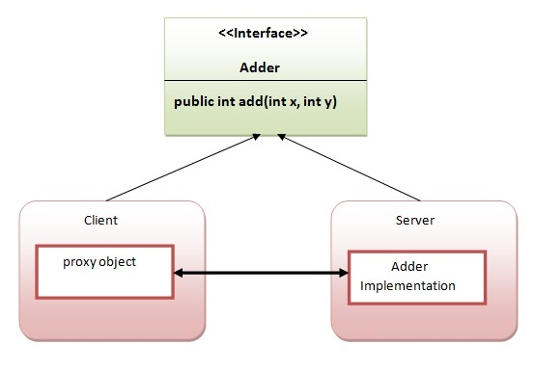
In this example, we have followed all the 6 steps to create and run the rmi application. The client application need only two files, remote interface and client application.
In the rmi application, both client and server interacts with the remote interface. The client application invokes methods on the proxy object, RMI sends the request to the remote JVM. The return value is sent back to the proxy object and then to the client application.

Slide 14
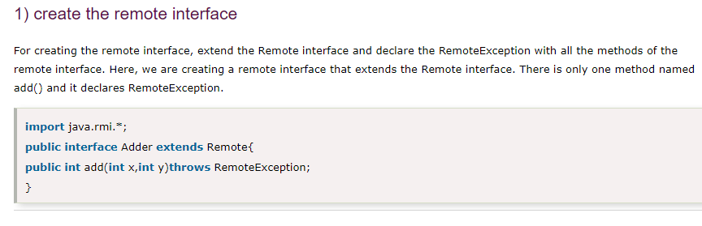

Slide 15
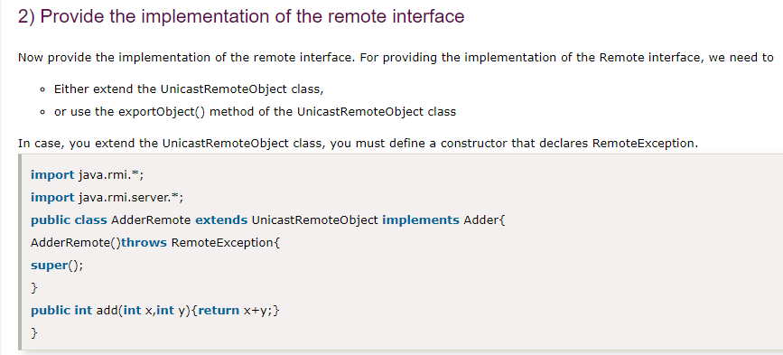

Slide 16
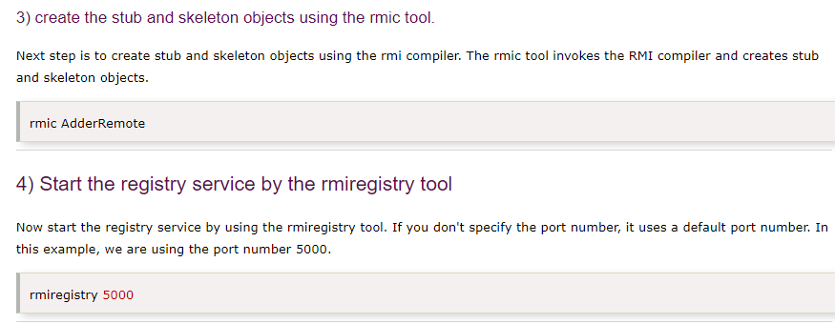

Slide 17
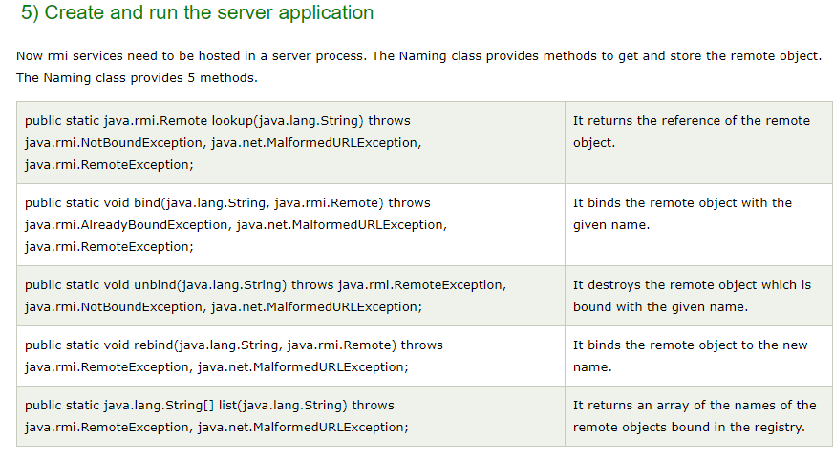

Slide 18
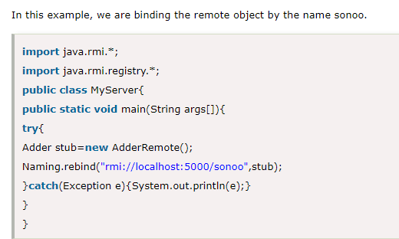

Slide 19
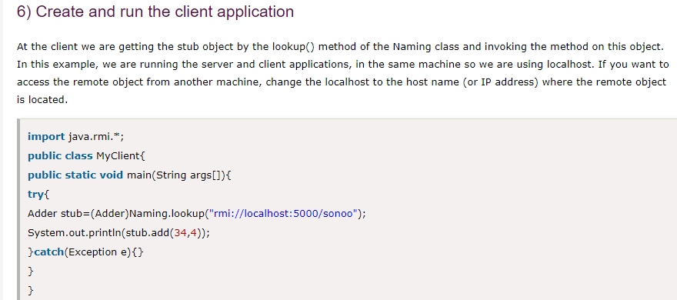

Slide 20
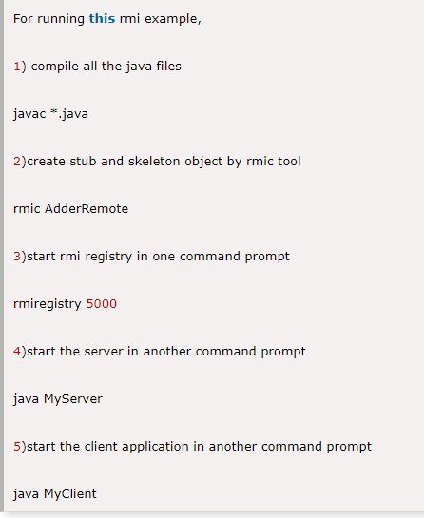

Slide 21
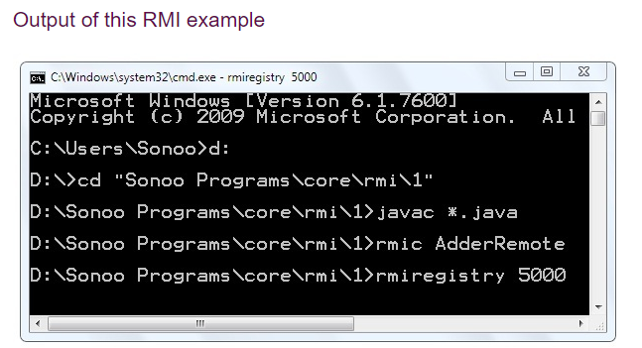
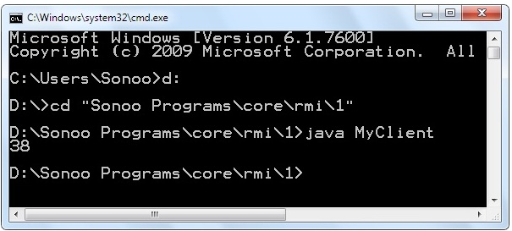
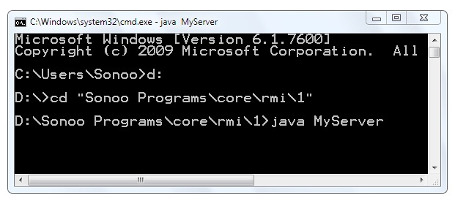

Slide 22
Steps for RMI Application
Define the remote interface
Develop the implementation class (remote object)
Develop the server program
Develop the client program

Slide 23
Q. Write a program using RMI to find sum and difference of two numbers. Methods sum and difference should be invoked from some remote machine. [Model Question, BSC CSIT , TU ]
The Server/Remote Machine will have following three things:
Message Interface
Message Implementation Class (which implements Message Interface)
Server Class (Creates Registry Lookup by the client)
The Client Machine will have following two things:
Message Interface
Client Class

Slide 24
Message.java
import java.rmi.Remote;
import java.rmi.RemoteException;
public interface Message extends Remote
{
double sum(double num1, double num2) throws RemoteException;
double difference(double num1, double num2) throws RemoteException;
}

Slide 25
/MessageImplementation.java
import java.rmi.RemoteException;
import java.rmi.server.UnicastRemoteObject;
public class MessageImplementation extends UnicastRemoteObject implements Message {
public MessageImplementation() throws RemoteException {
}
@Override
public double sum(double num1, double num2) throws RemoteException {
return num1 + num2;
}
@Override
public double difference(double num1, double num2) throws RemoteException {
return num1 - num2;
}
}

Slide 26
Server.java
import java.rmi.registry.LocateRegistry;
import java.rmi.registry.Registry;
public class Server {
private void startServer() {
try {
Registry registry = LocateRegistry.createRegistry(1099);
registry.rebind("myMessage", new MessageImplementation());
}
catch (Exception e) { e.printStackTrace(); }
}
public static void main(String[] args) {
Server main = new Server();
main.startServer();
} }

Slide 27
Client.java
public class Client {
private void doTest() {
try {
Registry myRegistry = LocateRegistry.getRegistry("127.0.0.1", 1099);
Message implementation = (Message) myRegistry.lookup("myMessage");
double s = implementation.sum(1, 2);
double d = implementation.difference(3, 4);
System.out.println("Sum:" + s + "\tDifference:" + d);
} catch (Exception e) { e.printStackTrace(); }
}
public static void main(String[] args) {
Client main = new Client(); main.doTest();
} }

Slide 28
Other Questions
What is RMI? Discuss architecture of RMI in detail. [TU Exam Question 2070. ]
what is RMI ? How can you use RMI to develop a program that runs in different machine? Discuss with suitable example. [TU Exam Question 2071.]
What is RMI? Differentiate it with CORBA. [TU Exam Question 2072.]

Slide 29
CORBA
The Common Object Request Broker Architecture (CORBA) is a standard developed by the Object Management Group (OMG) to provide interoperability among distributed objects.
CORBA is the world's leading middleware solution enabling the exchange of information, independent of hardware platforms, programming languages, and operating systems.
CORBA is often described as a "software bus" because it is a software-based communications interface through which objects are located and accessed.

Slide 30
RMI vs CORBA
RMI is a Java-specific technology. CORBA has implementations for many languages. You can use CORBA to share objects between programs written in different languages (e.g. C++ and Java).
CORBA uses IDL (Interface Definition Language) to separate interface from implementation. RMI just uses Java interfaces.
Because CORBA is not tied to a particular language, the data types do not always map exactly to the types used by your programming language (e.g. a long in IDL is an int in Java).
RMI programs can download new classes from remote JVMs. CORBA doesn't have this code sharing mechanism.

Slide 31
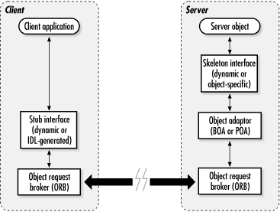
The CORBA Architecture

Slide 32
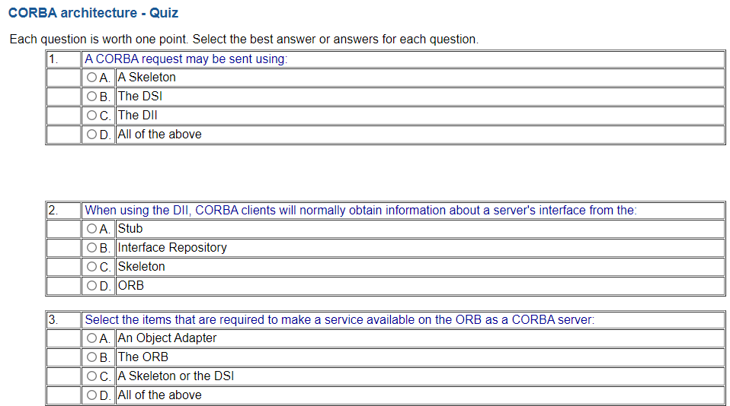
1. C
2. B
3. D

Slide 33
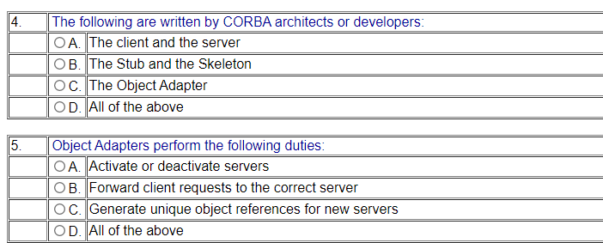
4. A
5. D

Slide 34
MCQs
1. Java supports RMI, RMI Stands for?
a. Random Method Invocation
b. Remote Memory Interface
c. Remote Method Invocation
d. Random Method Invocation
Ans: c

Slide 35
In RMI Architecture which layer Intercepts method calls made by the client/redirects these calls to a remote RMI service?
a. Stub & Skeleton Layer
b. Application Layer
c. Remote Reference Layer
d. Transport Layer
ANS: a
Which is an object, acts as a gateway for the client side, all the outgoing requests are routed through it and it resides at the client side and represents the remote object?
a. Stub
b. Skeleton
c. Both A & B
d. None of the above
Ans: a

Slide 36
An RMI Server is responsible for _______
a. Creating an instance of the remote object
b. Exporting the remote object
c. Binding the instance of the remote object to the RMI registry
d. All mentioned above
Ans: d
Which package is used for Remote Method Invocation (RMI)?
a. java.lang.rmi
b. java.lang.reflect
c. java.applet
d. java.rmi
Ans: d
RMI Architecture consists of how many layers?
a. 5
b. 3
c. 4
d. 2
Ans: 4

Slide 37
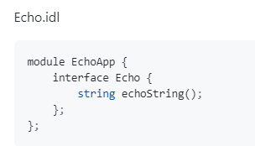
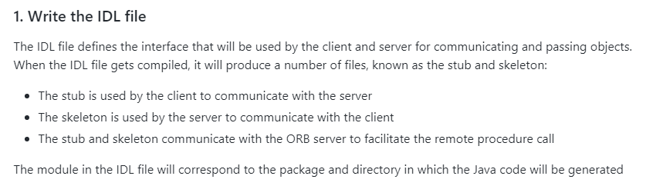
CORBA-Example

Slide 38
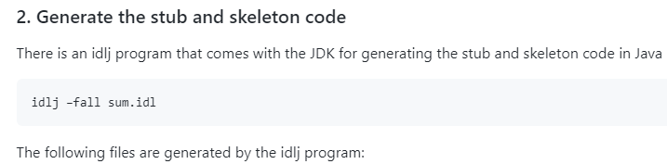
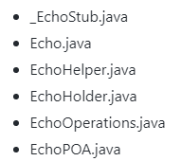
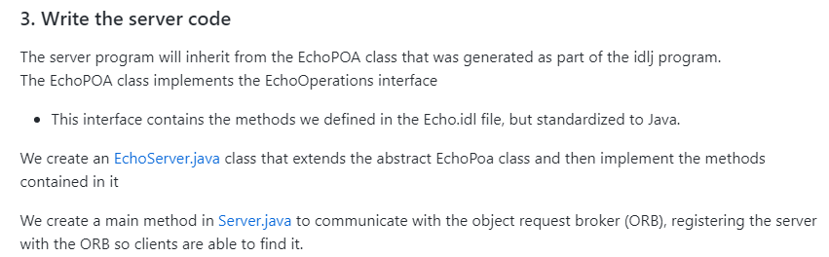

Slide 39
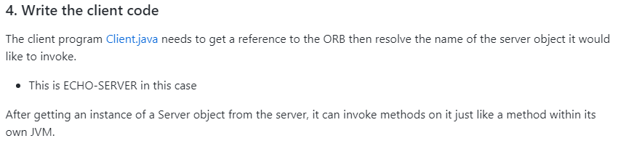



Compile the stub and skeleton from the directory that contains the IDL file.
Generate a JAR file from the compiled stub and skeleton.
Compile the server and client classes

Slide 40
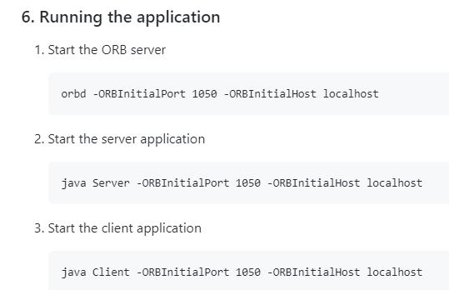


Slide 41
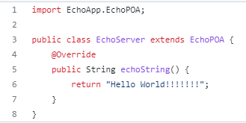
EchoServer.java

Slide 42
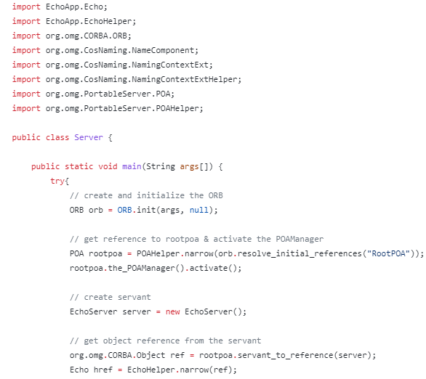
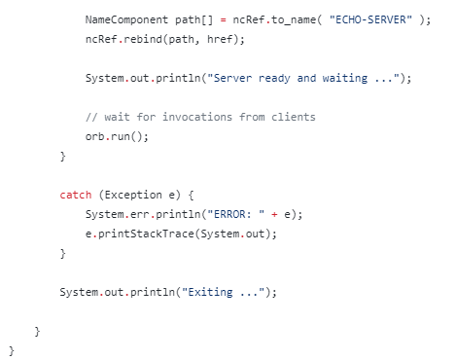
Server.java

Slide 43
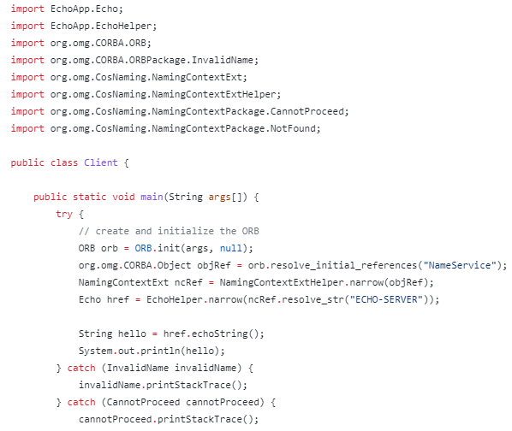
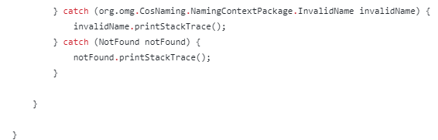
Client.java

Slide 44
Best of Luck
Any Questions??

